Slide 1
Slaviša Đurđić
COVID19
Coronavirus disease 2019 (COVID-19) is a contagious disease caused by the virus severe acute respiratory syndrome coronavirus 2 (SARS-CoV-2). The first known case was identified in Wuhan, China, in December 2019. The disease quickly spread worldwide, resulting in the COVID-19 pandemic.
https://en.wikipedia.org/wiki/COVID-19
Goal: Analysis of the US covid19 situation by state and county during 2020 - mid 2023.
Instructions:
- Collect data by downloading the "bigquery-public-data.covid19_usafacts.summary" dataset available on - BigQuery.
- Load the data to MySQL table(s).
- Execute some basic SQL queries to get first insights about the data.
- Build visuals in Power BI Desktop.
- Run statistical models.
Belgrade, May 2023

Slide 2
MySQL queries
Confirmed that NULL values don't exist in the table:
SELECT COUNT(*) FROM data_analysis.publicbigquery_covid19_usafacts_summary
WHERE deaths IS NULL OR confirmed_cases IS NULL OR date IS NULL OR state_fips_code IS NULL
OR state IS NULL OR county_name IS NULL OR county_fips_code IS NULL;
It seems that there are no duplicates:
WITH cte AS (
SELECT county_fips_code, county_name, state, state_fips_code, date, confirmed_cases, deaths,
ROW_NUMBER() OVER(PARTITION BY county_fips_code, county_name, state, state_fips_code, date, confirmed_cases, deaths) AS RN
FROM data_analysis.publicbigquery_covid19_usafacts_summary
)
SELECT *
FROM cte
WHERE RN > 1;

Slide 3
MySQL queries
Top 5 states with the highest deaths:
SELECT state, SUM(deaths) AS deaths
FROM data_analysis.publicbigquery_covid19_usafacts_summary
WHERE date = '2023-05-29' # Last available date in the sample
GROUP BY state
ORDER BY SUM(deaths) DESC
LIMIT 5;
> state deaths
> CA 101918
> TX 92378
> FL 88505
> NY 77558
> PA 51144

Slide 4
MySQL queries
Joined with data from the Census Bureau's American Community Survey to determine which counties (ohter than unallocated) had the most confirmed COVID-19 cases per 100,000 residents as of 2023-05-29 (last date):
SELECT
covid19.state, covid19.county_name, ROUND(confirmed_cases/total_pop *100000,2) AS confirmed_cases_per_100000, ROUND(deaths/total_pop *100000,2) AS deaths_per_100000, confirmed_cases, deaths, total_pop AS county_population
FROM `publicbigquery_covid19_usafacts_summary` covid19
JOIN `publicbigquery_census_bureau_acs_county_2020_5yr` acs ON covid19.county_fips_code = acs.geo_id
WHERE date = '2023-05-29' # Last date reported AND county_fips_code != "00000“ AND confirmed_cases + deaths > 0
ORDER BY confirmed_cases_per_100000 DESC, deaths_per_100000 DESC
LIMIT 5;
> state county_name cases_per_100K deaths_per_100K cases deaths county_population
> TX Loving County 350427.35 854.7 410 1 117
> TX Delta County 188004.55 530.6 9921 28 5277
> TX Jim Hogg County 73395.03 443.42 3807 23 5187
> GA Chattahoochee County 66103.15 229.23 6921 24 10470
> TX Dimmit County 61043.78 508.21 6246 52 10232

Slide 5

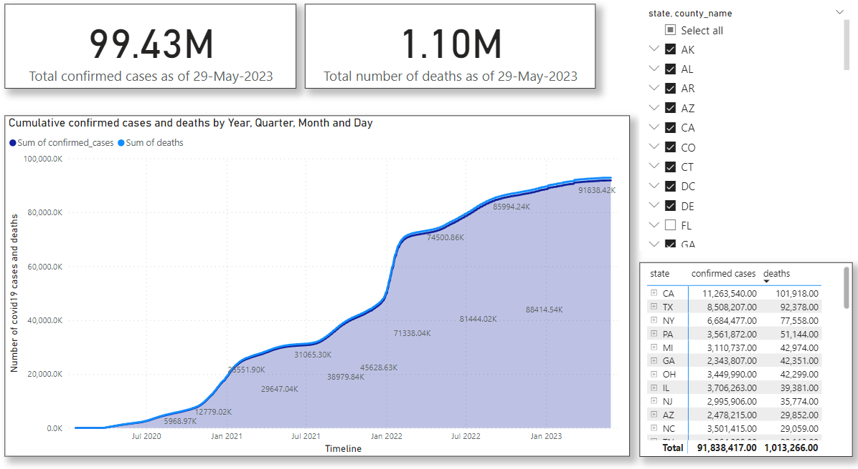
Microsoft Power BI

Slide 6
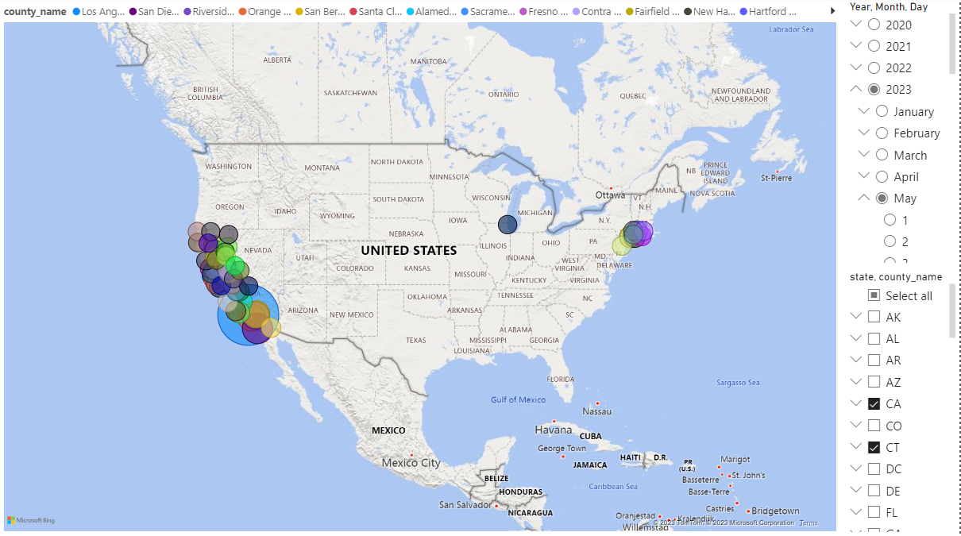
Microsoft Power BI

Slide 7
Regression Analysis
'The Simple Linear Regression model allows us to summarize and examine relationships between two variables. It uses a single independent variable and a single dependent variable and finds a linear function that predicts the dependent variable values as a function of the independent variables.
The Coefficient of Correlation is a statistic we use to determine if there is a relationship between two variables. The output of this statistic equals somewhere between 1 and -1. The closer to 1 the number is, the more positively related the variables are. If X increases, Y increases. The closer to -1 the number is, the more negatively related the variables are. If X increases, Y decreases.
The Coefficient of Determination is a related statistic that then tells us how well our model fits the data. This statistic is always between 0 and 1, and the closer to 1 the value is, the better our model fits the data set.’
https://3cloudsolutions.com/resources/simple-linear-regression-in-power-bi/
'Linear Regression is a statistical model applied to businesses to help forecast events based on historical trend analysis. Simple Linear regression uses one variable, called the independent variable. The independent variable predicts the outcome of another variable called the dependent variable.
A Linear Regression Model is created by fitting a trend line to a dataset where a linear relationship already exists.
This trend line has the equation of y = mx + b and is used to make estimates.’
https://iterationinsights.com/article/linear-regression-in-power-bi/

Slide 8
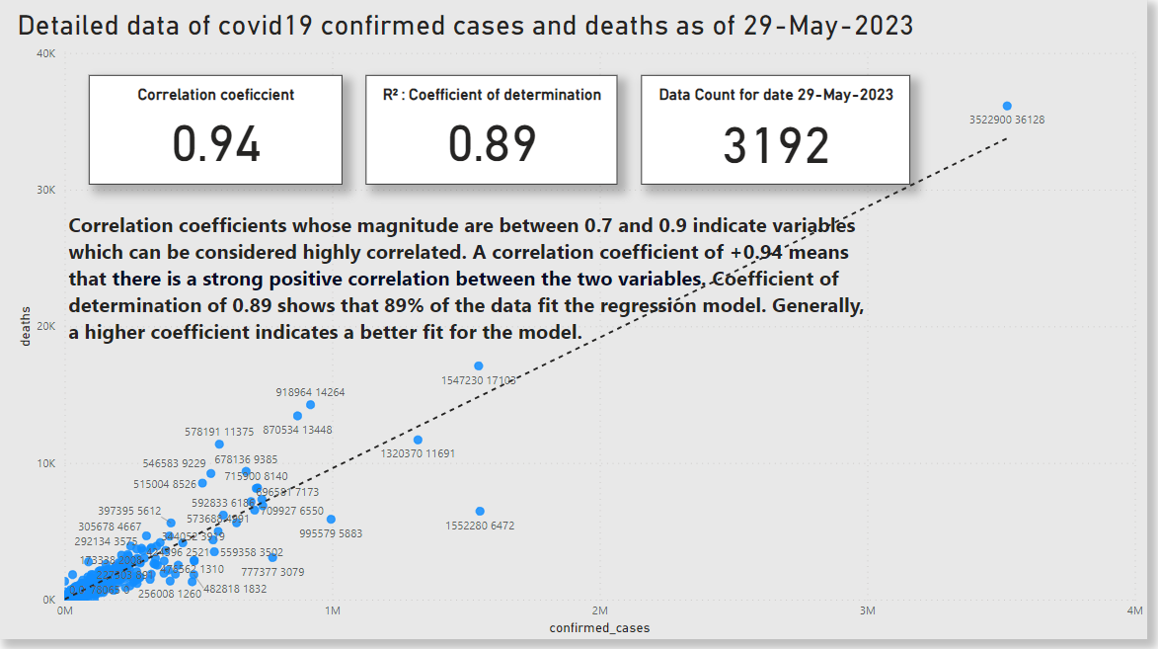
Microsoft Power BI

